Slide 1
P.R.E.S.S. Pressure Reactive Electronic Solar Stones
Group # 20
Amanda Ross (EE)
Benjamin Gafoor (EE)
Mariah Kenny (EE)
Phillip Dunlop (EE)
Funded by:
Leidos
Duke Energy

Slide 2
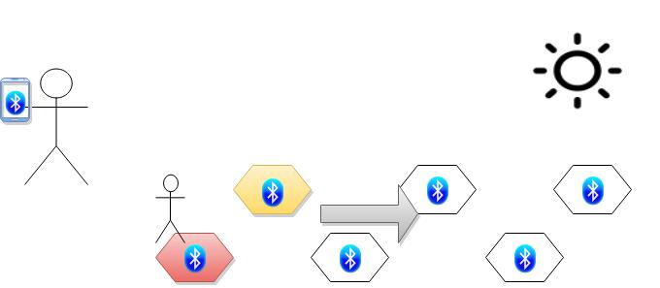
Goals & Objectives
Provide the user an easy way to brighten an outdoor pathway
To use renewable energy as a power source specifically solar energy
Design a system that is completely self sustained and easily operated by the user.

Slide 3
Specifications
Each stone structure should be able to hold up to 250 lbs and be completely weather proof.
Stones will be activated by change in pressure or phone application
All power obtained by solar energy
Wireless communication via Bluetooth LE
Phone application to be available on Android Devices

Slide 4
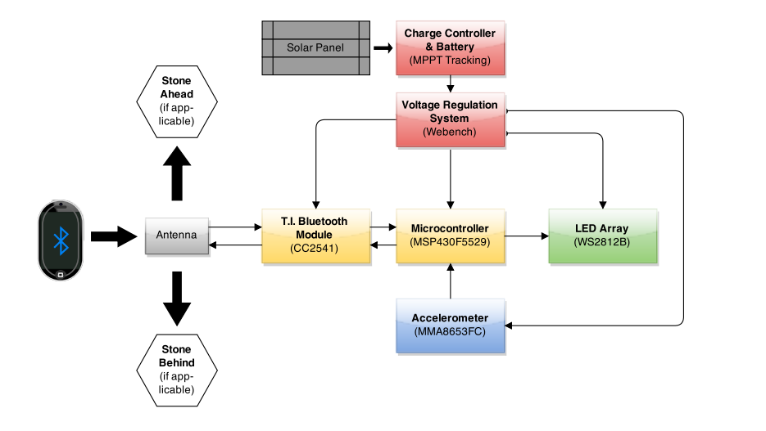
Overall System Block Diagram

Slide 5
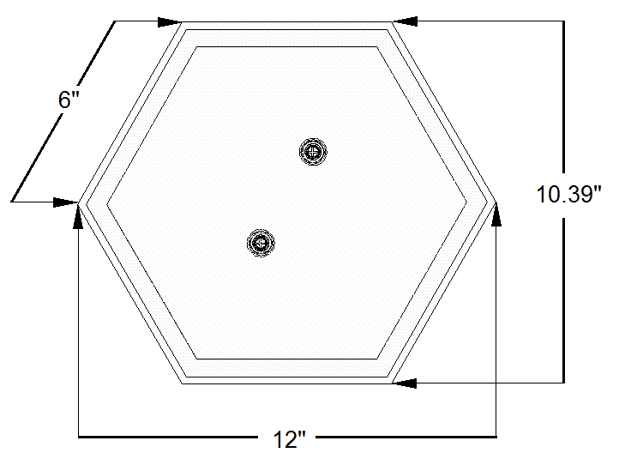
Structure – Top View
Hexagon Shaped
Plexiglas top
Treated Pine wood sides
Thompson’s water sealant
Clear epoxy sealant for edges
¼” x 3 ½” screws and tunnels for binding top to body

Slide 6
Structure - Side View

Slide 7
Structure - Inside Top View

Slide 8
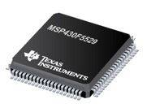
MCU
Features | Specifications
Flash (kB) | 128
Frequency (MHz) | 25
I2C | 2
SPI | 4
UART | 2
Min VCC (V) | 1.8
Max VCC (V) | 3.6
RAM (kB) | 8
I/O | 63
MSP 430F5529 – 16 bit Ultra Low Power Microcontroller
Low power consumption perfect for solar energy
Internal configurable clock speeds
9.8mm
9.8mm

Slide 9
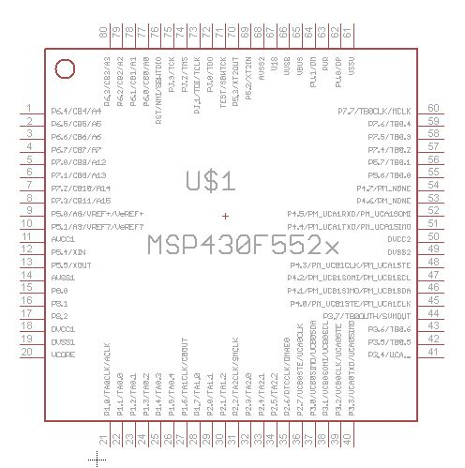
MCU
Chose this MCU due to the number of I2C and SPI ports.
Low power
Familiar with programming environment
Dev-board available for free
Open source schematics for reverence on Texas Instruments website
MSP430 libraries for EagleCAD open source

Slide 10
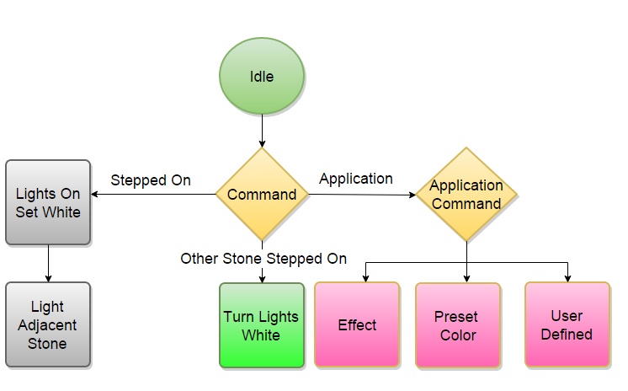
Lighting Flow Chart

Slide 11
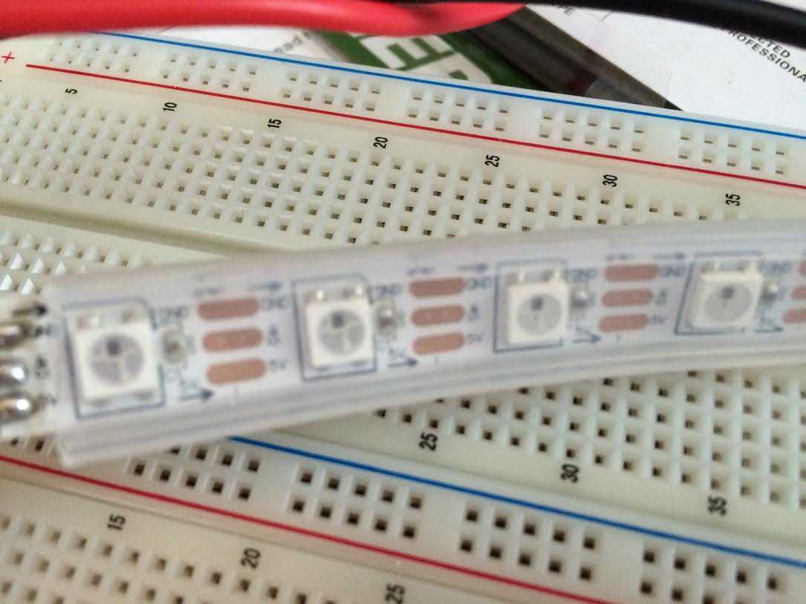
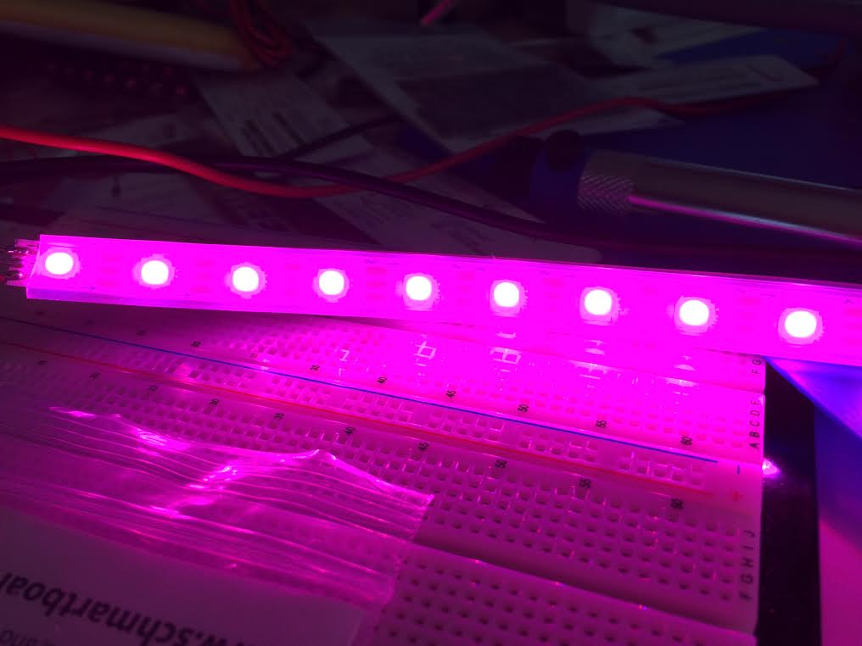
LEDs – WS2812
LED with low driving voltage, environmental protection and energy saving, high brightness, viewing angle is large, good consistency, low power, long life and other advantages.
Has LED driver built into each individual LED
Comes mounted on flexboard PCB
Comes with weatherproof casing
RGB colors gives 16777216 possible colors

Slide 12
WS2812 Specifications
Parameter | Rating
Power Supply Voltage VDD | +3.5 - +5V
Input Voltage | -0.5-0.5 V
Viewing Angle | 120 degrees
RGB IC Characteristic | Intensity + Voltage
Red | 390-420 mcd 2-2.2 V
Green | 660-720 mcd 3-3.4 V
Blue | 180-200 mcd 3-3.4 V
Each LED takes 8 bits for each primary color for brightness, requiring 24 bits to program an individual LED.

Slide 13
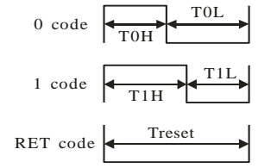
WS2812 Specifications
DATA TRANSFER | TH+TL = 1.25 µs
T0H | 0 code, high voltage time | 0.4 µs | ± 150 ns
T0L | 0 code, low voltage time | 0.85 µs | ± 150 ns
T1H | 1 code, high voltage time | 0.8 µs | ± 150 ns
T1L | 1 code, high voltage time | 0.45 µs | ± 150 ns
RES | Low voltage time | Above 50 µs

Slide 14
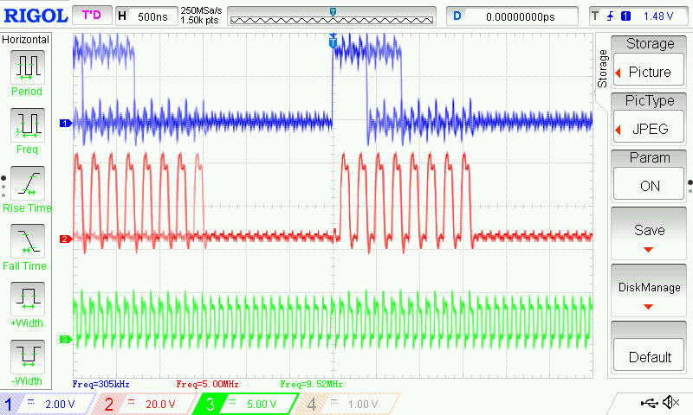
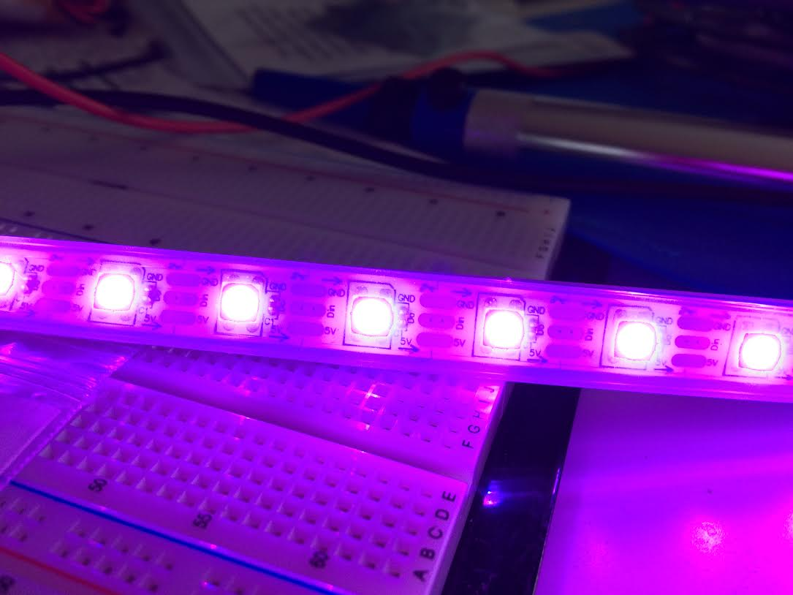
MCU Output for LEDs
LED Data
SPI CLK
Signal | Frequency
LED Data | 305 kHz
SPI CLK | 5 MHz
SMCLK | 10 MHz
SMCLK

Slide 15
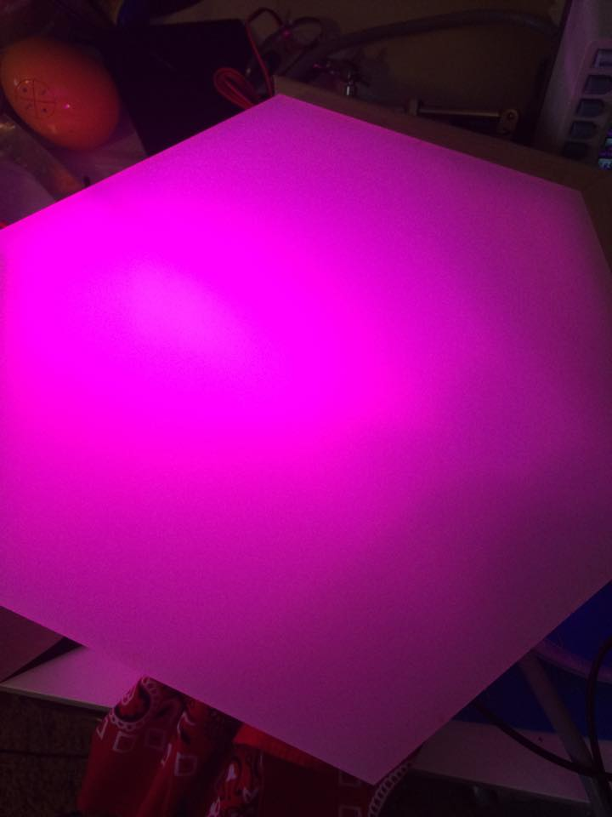
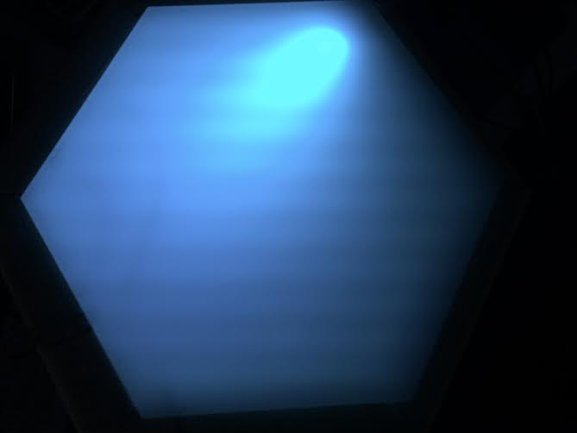
LEDs Inside Stone

Slide 16
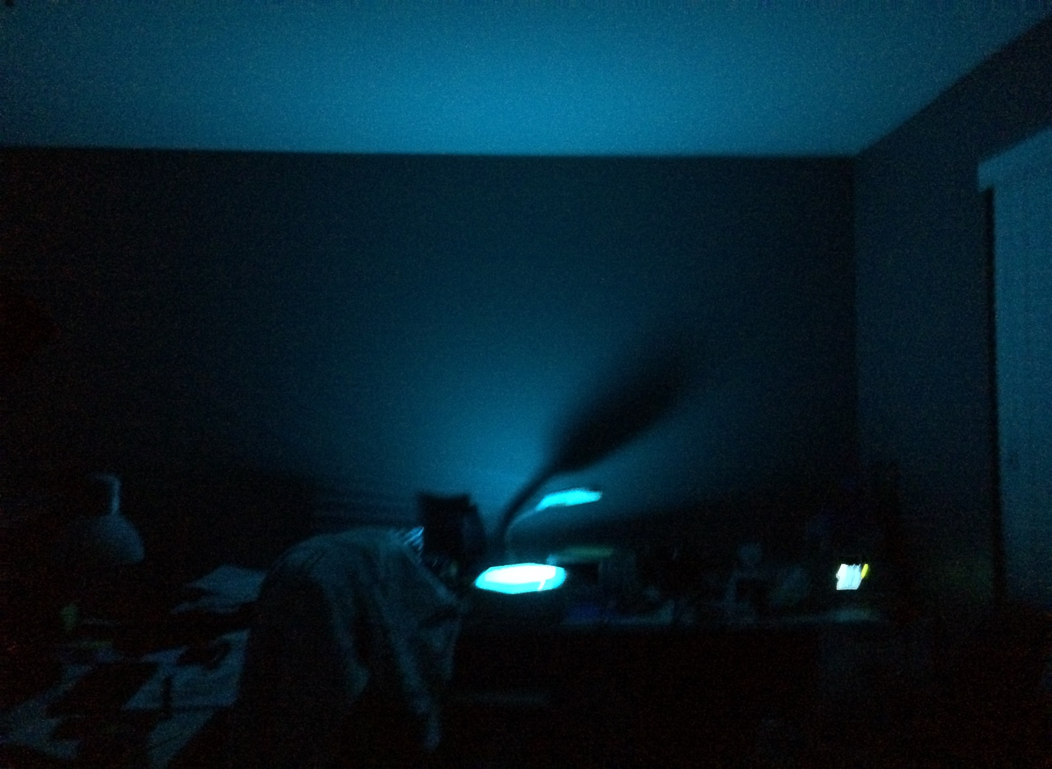
Luminance Test

Slide 17
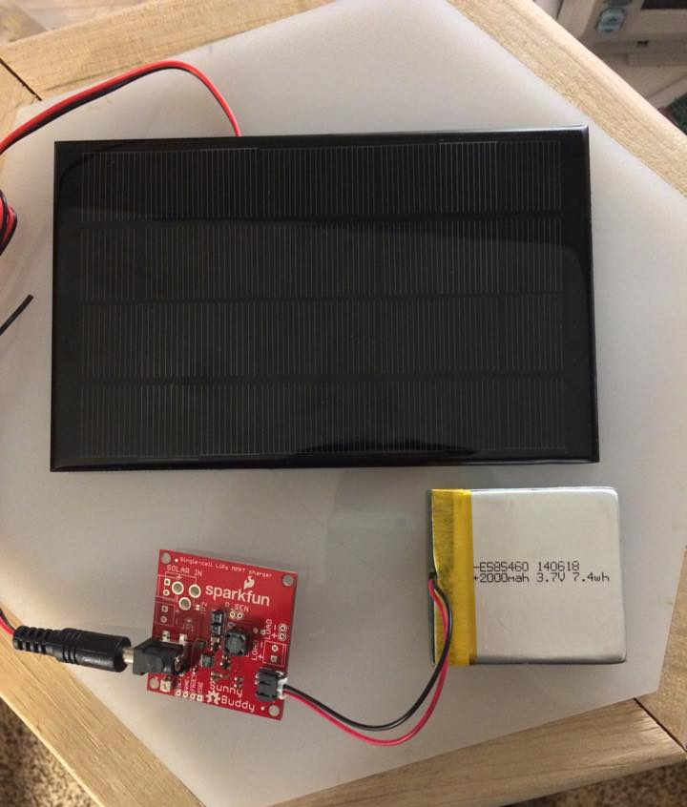
Solar Power System
Solar Panel – Monocrystalline PV Panel
Charge Controller – MPPT Solar Charger using LT3652
Battery – Lithium Ion Battery

Slide 18
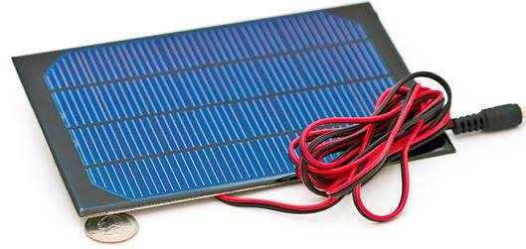
Solar Panel – Monocrystalline PV Panel
Specifications
Dimensions | 7 X 4.5 inches
Open Circuit Voltage | 8V
Short Circuit Current | 310 mA
Power Supplied | 2.5 Watts
Efficiency | 15-15.2%

Slide 19
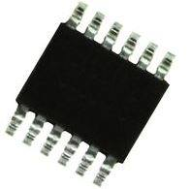
MPPT Charge Controller
LT3652 regulates voltage for MPPT tracking and peak output voltages.
Adjustable input voltage range from 5V – 32V and charge rate up to 2A.
Input supply regulation circuit at the Vin_reg pin keeps a minimum input voltage at 2.7V
4mm
3mm

Slide 20
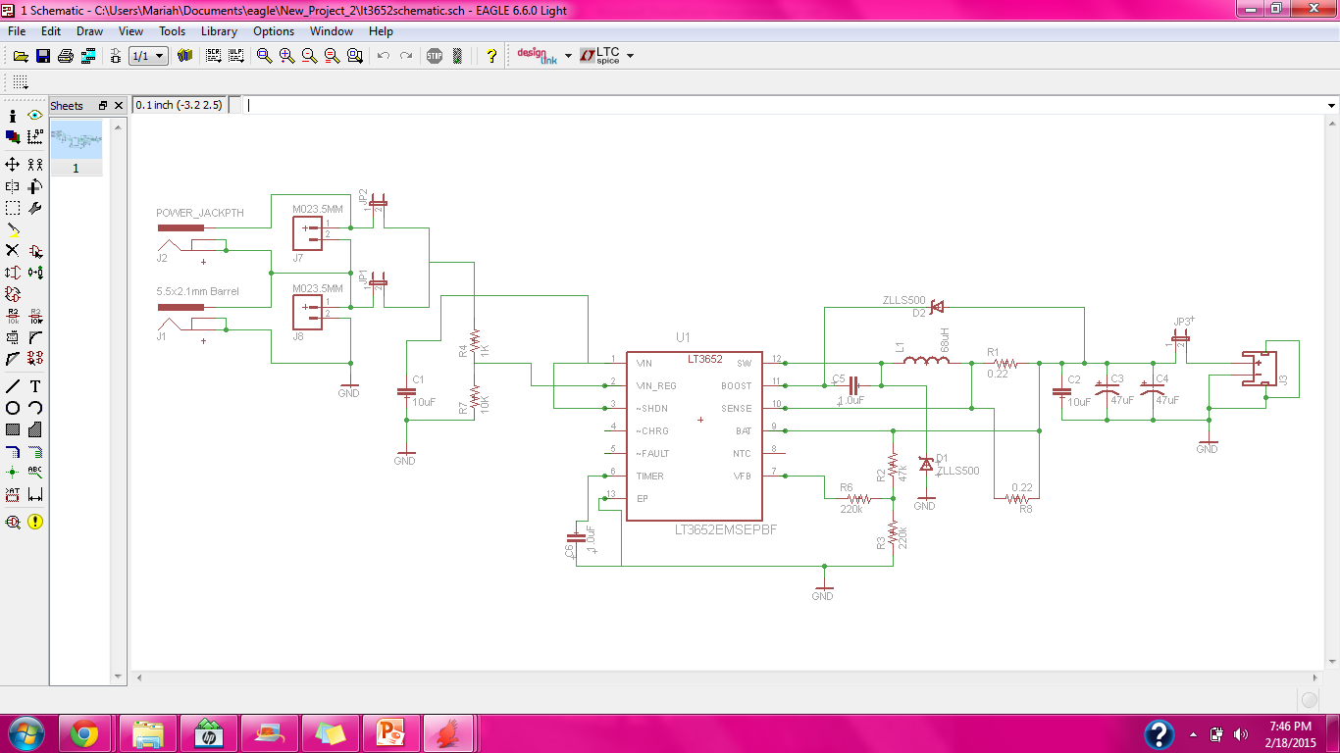
MPPT Schematic

Slide 21
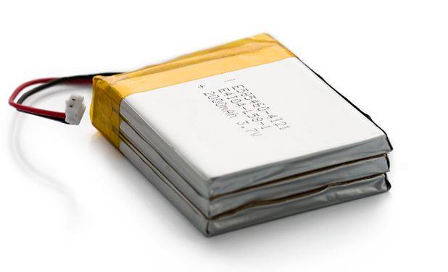
Battery – Polymer Lithium Ion Battery
Three 2000 mAH lithium ion batteries stacked in parallel to increase amount of storage.
Great for extreme weather conditions ranging from -25 to 60 C.
Charged in 4 hours of direct sunlight from solar panel.
Specifications
Nominal Capacity | 6 Ah
Nominal Voltage | 3.7 V
Charge voltage | 4.2 V
Discharge Current | 1 A continuous
19mm
60mm
54mm

Slide 22
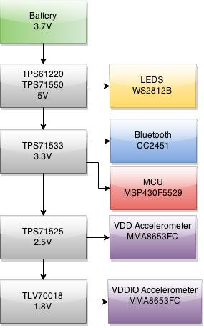
DC – DC Converters

Slide 23
Bluetooth Vs. Wi-Fi
Decision needed to be made between Wi-Fi and Bluetooth for the wireless communication between the stones.
Wi-Fi has much faster transmission speeds and longer range. However uses much more power and is more complex to implement.
Bluetooth is energy efficient and simpler to utilize. Slower transmission speeds and shorter range will not be an impact on our project.

Slide 24
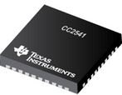
Bluetooth Module
Specifications
Bluetooth Standard | Bluetooth Low Energy
Flash Size (KB) | 256
RAM size (KB) | 8
RX Current (mA) | 17.9
Standby Current (uA) | 0.5
Wakeup Time (us) | 500
Supply Voltage (V) | 2 - 3.6
The Bluetooth module that was chosen was the CC2541 from TI.
Very low power consumption.
6.15mm
6.15mm

Slide 25
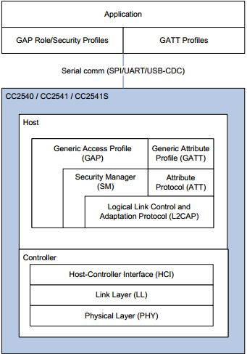
Bluetooth Module
MSP430F5529
Bluetooth Module will be run in Network Processor mode.
Application code is run in the MSP430 while the BLE stack is run in the CC2541. Communication between the chips via SPI.
Beneficial as the Code Composer environment and MSP430 are more familiar than the IAR environment and the CC2541.

Slide 26
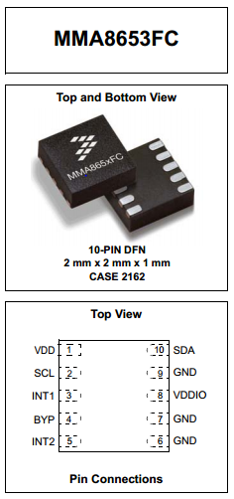
Accelerometer
MMA8653FC 3 Axis 10-bit Accelerometer
Designed to Slave to a Master Microcontroller Unit
Monitors inertial events while still remaining in a low power mode during periods of inactivity
Communicates via I²C digital output
Interrupts to observe and account for sequential movement.
Dynamically selectable detection ranges
Can operate at a supply voltage between 1.95 and 3.6 V
Capable of operating between -40° and 170° F
© Freescale Semiconductors Inc.

Slide 27
Accelerometer I²C Interface
Using I²C Communication, Accelerometer slaved to Master MCU is capable of single and multiple byte read/write functions
I²C Device Address Sequence
Command | Device Address (Slave) | R/W | 8-bit Final Value
Read | 0011101 (0x1D) | 1 | 0x3A
Write | 0011101 (0x1D) | 0 | 0x3B
© Freescale Semiconductors Inc.

Slide 28
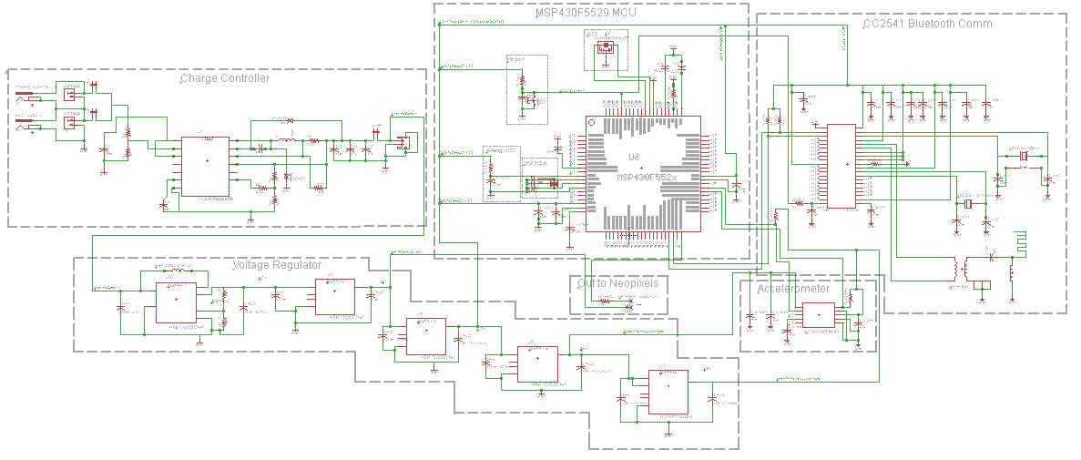
PCB Design

Slide 29
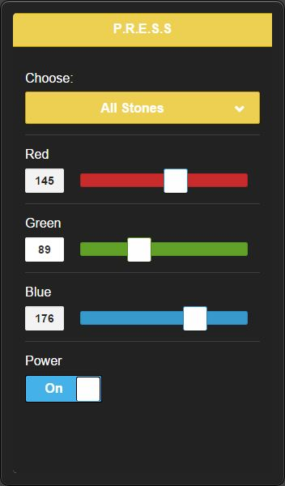
Application
Mobile application will be developed for Android devices using the Android SDK.
Primary features include:
Wirelessly connect to stones using BLE technology.
Once connected be able to manually turn on the stones.
Change color of stones via color sliders and premade color swatches.

Slide 30
Application Flow Chart
Application will only function on BLE capable device and software (Android 4.3 or greater). Development done using Nexus 5 running Android 5.0.1.
Bluetooth needs to be enabled on device, this can be done from in the application.
Bluetooth scanning is very battery intensive. A scan timeout is used to prevent infinite scanning.

Slide 31
Application Important Classes
BluetoothGatt
Provides GATT (Generic Attribute Profile) functionality in order to communicate to BLE devices.
BluetoothGattCallback
Allows for callbacks on the result of read/write operations or connection changes.
BluetoothGattCharacteristic
A GATT Characteristic is the basic data element used in communication that contains both the data to be communicated and additional information such as permissions, properties or UUID.
BluetoothGattService
A service is a collection of characteristics. This method will allow us to add and manage characteristics in our service.

Slide 32
Flex Goals
Enabling user to customize stone amount via application interface (adding or subtracting stones from network as needed)
Possibly adding security features for an intruder detection mode
Stones sending a text message alert to the user when an intruder is present
Pattern selection via user interface for blinking and color changing sequences
User customized and pre-programmed pattern sequences
Audio sense for sound detection and light sequence in sync with noise pick-ups

Slide 33
Our Next Steps
Bluetooth and application interfacing in code.
Programming accelerometer and interfacing with MCU.
Working on a functional JTAG interface for on-board programming of MCU.
Laying out PCB footprint in EagleCAD and sending out PCB for fabrication.

Slide 34
Budget
Purchased
Qty | Item Category | Cost
1 | Solar Panel, Battery and Charge Controller | $ 92.85
60 | AdaFruit Neopixel LEDs | $ 34.13
4 | Schmartboards for prototyping | $ 54.01
1 | Sealant | $ 24.39
1 | Wood and Hardware for Structure Prototype | $ 40.69
1 | CC2541 Mini Development Kit | $ 106.00
2 | MSP430F5529 Launchpad Evaluation Kit | $ 32.98
8 | Header Connector (20 way) | $ 10.59
2 | 12" x 24" Frosted Plexiglas Sheet | $ 45.40
7 | MMA8653FC Accelerometer | $ 12.67
 | Total Spent: | $ 453.71
Needed
Qty | Item Category | Cost
5 | Solar Panel & Battery | $ 339.50
6 | Wood and Hardware for Stones | $ 244.14
6 | PCB Fabrication | $ 259.98
6 | Elec. Components (Cap, Ind, Oscillators etc.) | $ 125.00
6 | 12"x24" Frosted Plexiglas Sheet | $ 127.86
 | Total Future Spending: | $ 1,096.48
Total Spent + Future Spending: | $1,550.19
Leidos & Duke Total Granted Funding: | $2,190.00
Total Financial Gap/Buffer: | $639.81

Slide 35
Schedule
Task Name | Start | Finish | Resource Names
Research | Mon 9/1/14 | Wed 11/19/14 | Phill,Amanda,Mariah,Ben
Prototype | Thu 12/4/14 | Sat 2/28/15
Order Parts | Mon 1/5/15 | Mon 1/5/15 | Phill,Mariah,Amanda,Ben
Structure Prototype | Fri 1/16/15 | Fri 1/16/15 | Ben,Mariah,Amanda,Phill
Lighting Prototype | Fri 1/16/15 | Sat 2/28/15 | Ben
Application Prototype | Fri 1/16/15 | Fri 2/6/15 | Phill
Bluetooth LE Prototype | Fri 1/16/15 | Sat 2/28/15 | Phill,Amanda
Power Prototype | Fri 1/16/15 | Sat 2/28/15 | Mariah
Initial PCB Design | Fri 1/23/15 | Fri 2/27/15 | Amanda
Testing | Sun 2/1/15 | Mon 3/9/15
Mount Parts to Breakout Boards | Sat 2/7/15 | Sat 3/7/15 | Phill,Mariah,Amanda,Ben
Order PCB | Sat 3/7/15 | Sat 3/7/15 | Amanda
Lighting Test | Sun 3/1/15 | Sat 3/28/15 | Ben
Power Test | Sun 3/1/15 | Sat 3/28/15 | Mariah
Application Test | Sun 3/1/15 | Sat 3/28/15 | Phill
Wireless Communication Test | Sun 3/1/15 | Sat 3/28/15 | Amanda
Multi-stone Test | Sat 3/28/15 | Tue 3/31/15 | Mariah,Phill,Amanda,Ben
Mount Parts to PCB | Sun 3/29/15 | Sun 3/29/15 | Mariah,Phill,Amanda,Ben
Build | Mon 4/6/15 | Fri 4/24/15 | Mariah,Phill,Amanda,Ben
Test Whole System | Mon 4/6/15 | Wed 4/15/15 | Mariah,Phill,Amanda,Ben

Slide 36
Progress

Slide 37
Questions

